Slide 1
Hands-on : London Air Quality

Slide 2
Agenda
Developing Pentaho Demo showcasing the platform’s end-to-end capabilities
Problem Statement
Use Case Overview
Workshop Content
Demonstration Extension

Slide 3
Pentaho provides flexible management for end-to-end data flows…
Data Engineering
Data Prep
Analytics
Ingestion
Processing
Blending
Data Delivery
Data Discovery / Analysis
Analysis & Dashboards
Administration
Security
Lifecycle Management
Data Provenance
Dynamic Data Pipeline
Monitoring
Automation
Notes:
The Pentaho platform provides a single consistent experience across data engineering, data preparation and analytics.
Along with visualization and analytics at every step in the pipeline
Along with centralized management activities across the pipeline as shown in the bottom boxes.

Slide 4
Problem Statement

Slide 5
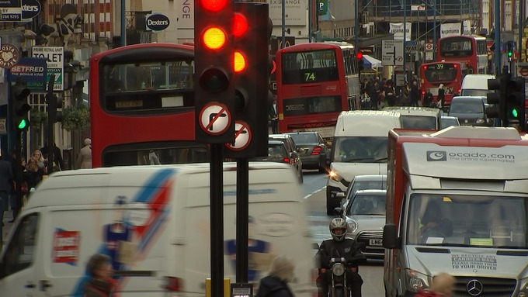

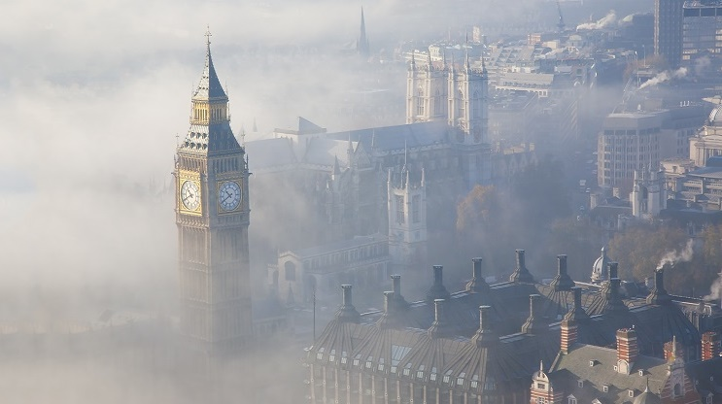
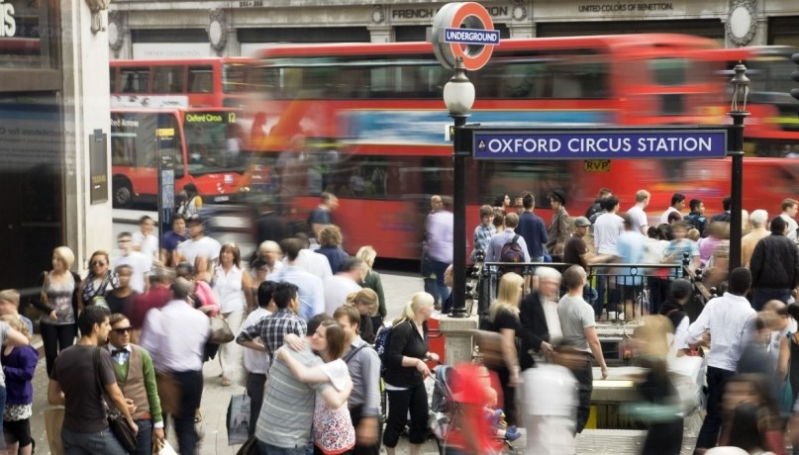
Use Case
“London Air Quality Monitoring”

Slide 6
Why?
Air quality affects well-being of residents and visitors of the city
9.000 early deaths a year in London due to air pollution
Air pollution monitoring and mitigation are crucial for city councils
The use case is easy to understand and to follow

Slide 7
Use Case Overview

Slide 8
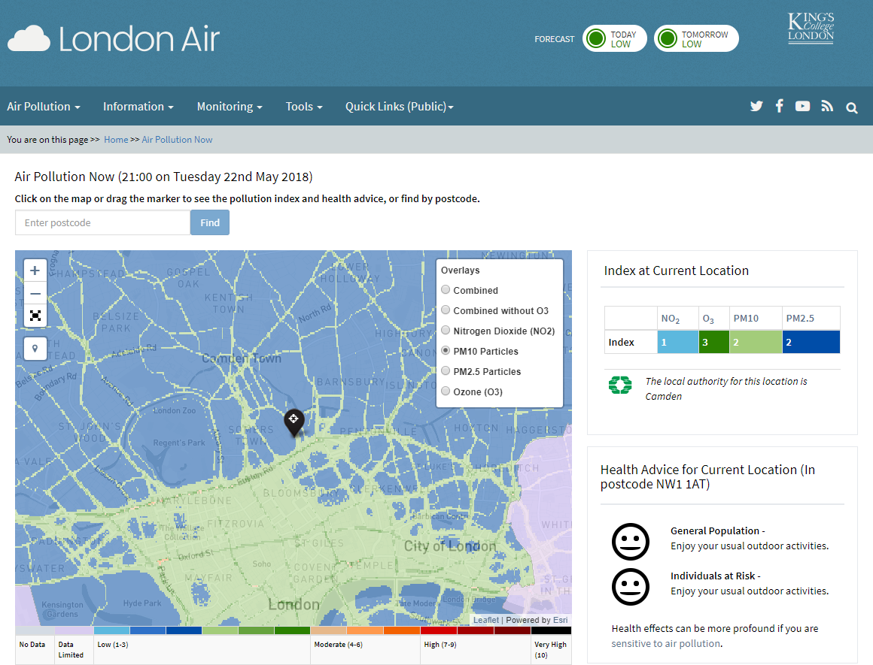
Data Source
London Air Quality Network (96 stations across the city)
www.londonair.org.uk
Live Data Feed via API
Notes:
These are the data sources that would be useful to tackling this issue however we will focus on the sensors in this workshop

Slide 9






Collecting, Preparing and Blending

Slide 10
Workshop Content

Slide 11
You Should Have...
Pentaho Data Integration Enterprise Edition installed
Handbook : “LAQ Pentaho-Workshop Handbook.pdf”
Supplementary file : “SiteCodePostCode.csv”
LAQ - Copy+Paste-Snippets.txt
London Air Quality - Final PDI Transformation.pdf

Slide 12
You Will Have...
A transformation that collects data from 96 monitoring stations across London
Blended air quality data with supplementary data (SiteCodePostCode.csv)
A transformation to create time tables for reporting
Analysis and Geospatial reports of air quality across London
An interactive dashboard of air quality across London

Slide 13
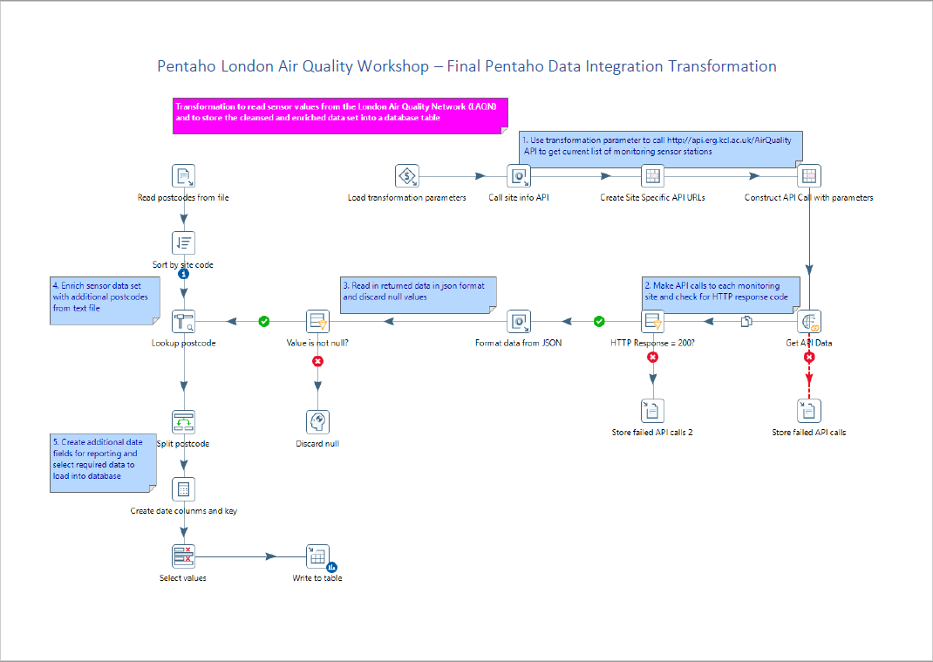
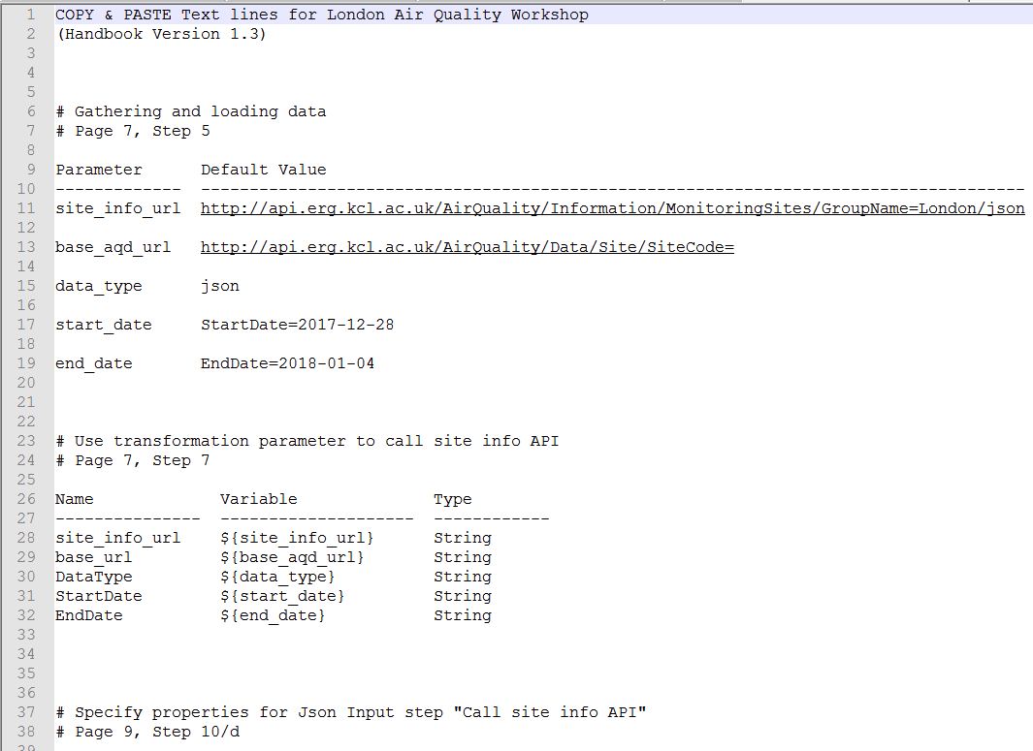
Supporting materials
For your reference, if you get stuck, etc.
LAQ - Copy+Paste-Snippets.txt
London Air Quality – Final PDI Transformation.pdf
Solutions of PDI transformations:
t_london_air_quality.ktr
t_create_month_day_tables.ktr

Slide 14
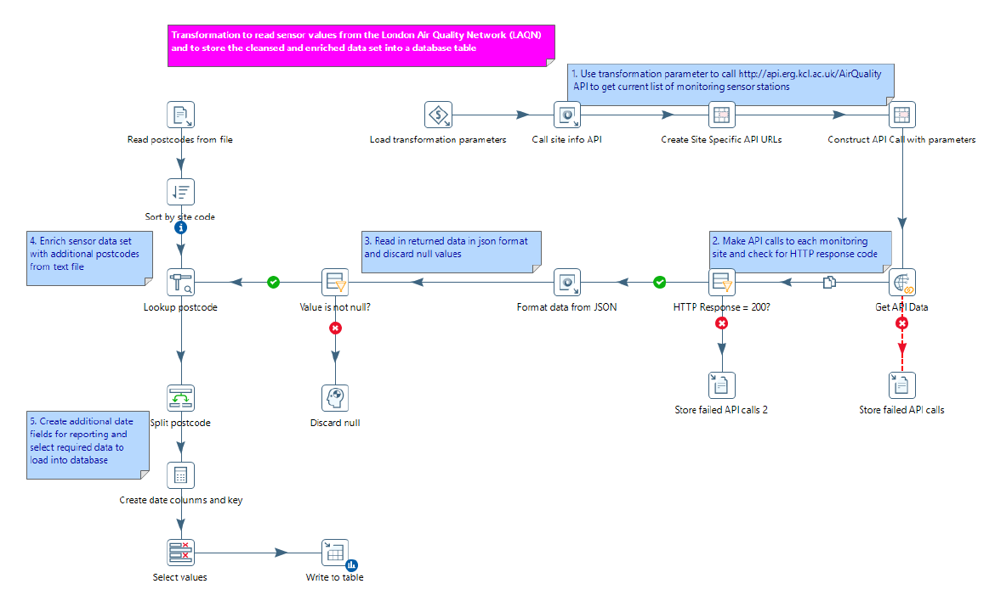
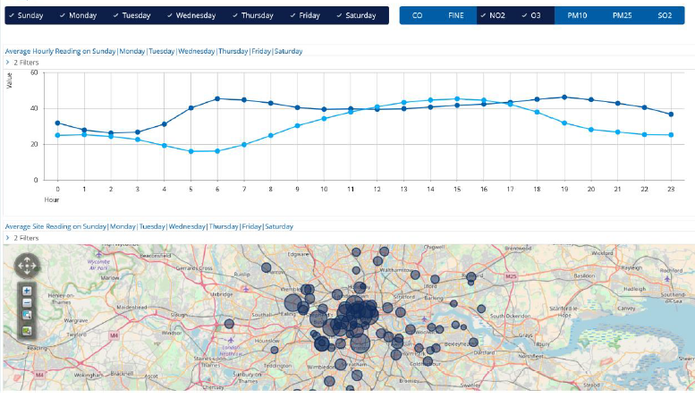
Process & Personas
ETL Developer
BA Administrator
Business User
From Data to Insights
Ingest sensor data from London Air Quality Network
Cleanse & enrich data stream
Load data set into database
Create dimensional model (ROLAP Cube) from selected database tables for reporting
Hide technical complexity by using business language, and providing pre-defined navigation & data formatting
Create visualisations of data, ad-hoc analysis based on the ROLAP Cube
Organize, link and share analytic content in dashboards

Slide 15
Extension Air Quality Prediction

Slide 16
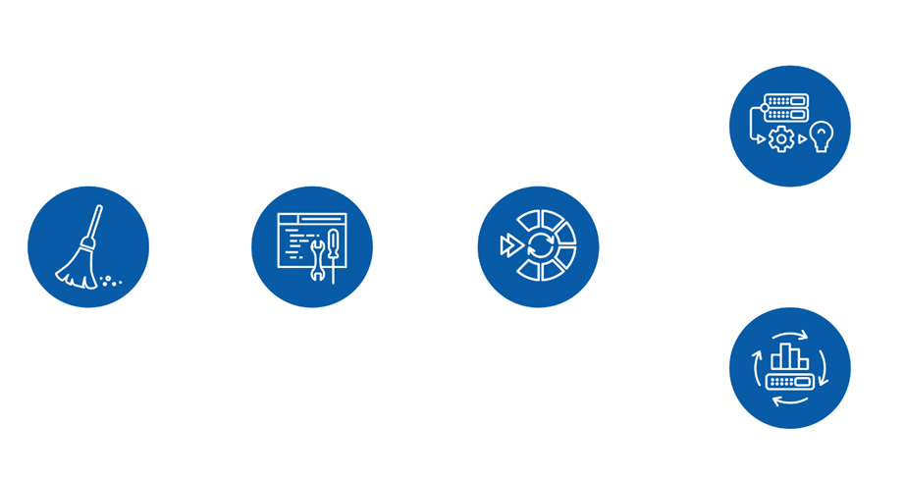
Pentaho Data Science Orchestration
Makes data science teams more productive
Broad support for open source libraries in various languages
Manage model performance, lineage and testing
Notes:
80% of a data scientist time is spent on preparing data and engineering features
PDI can make improve time to get data, train, tune and test and operationalise models

